Slide 1
Tutorial 5

Slide 2
Topics
BJT Biasing techniques
JFET current equation
CE amplifier

Slide 3
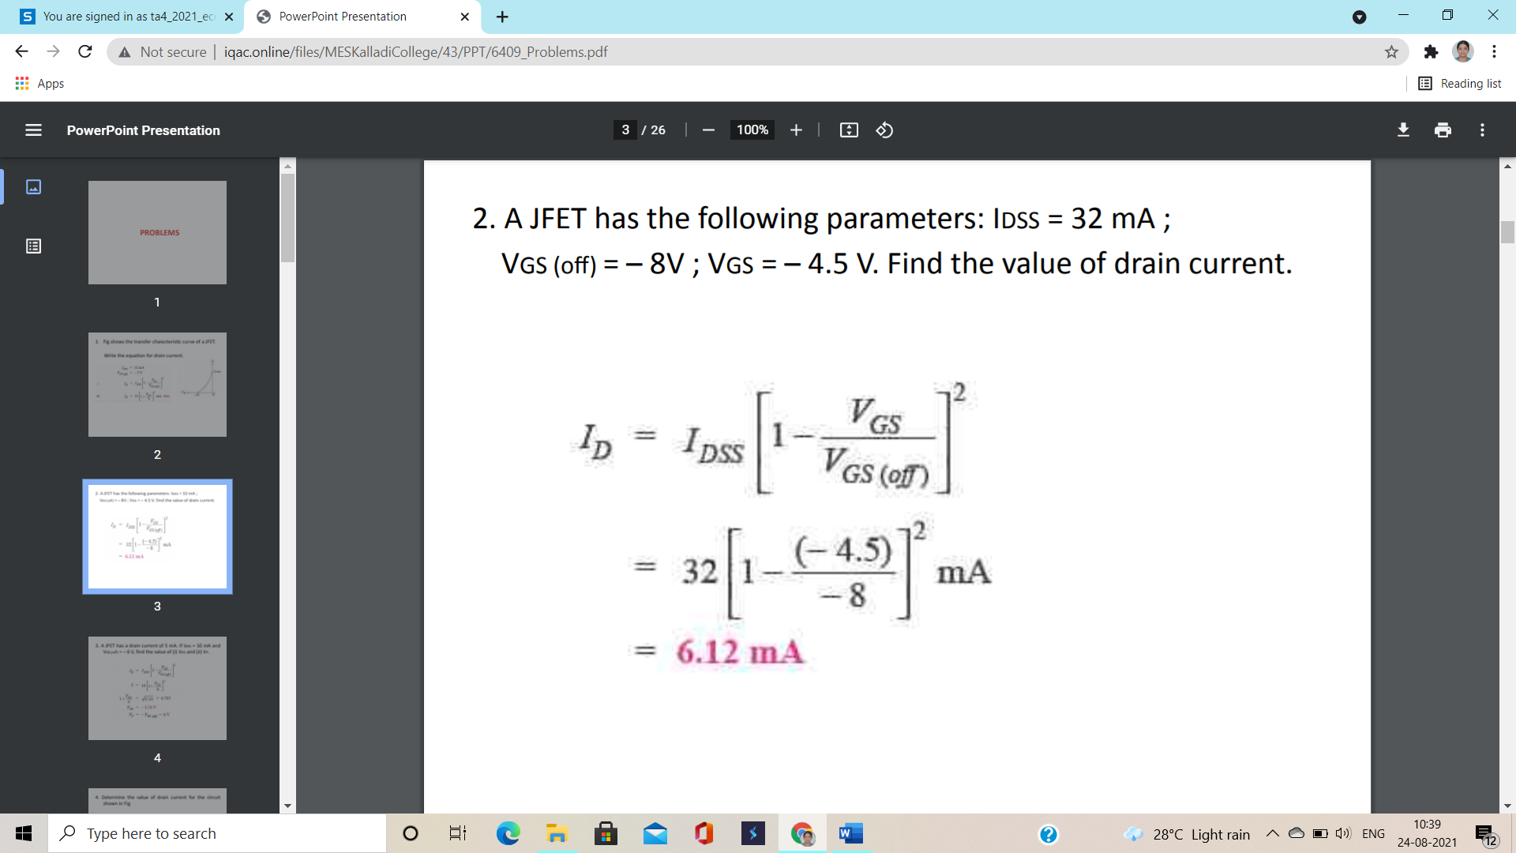
(1)

Slide 4
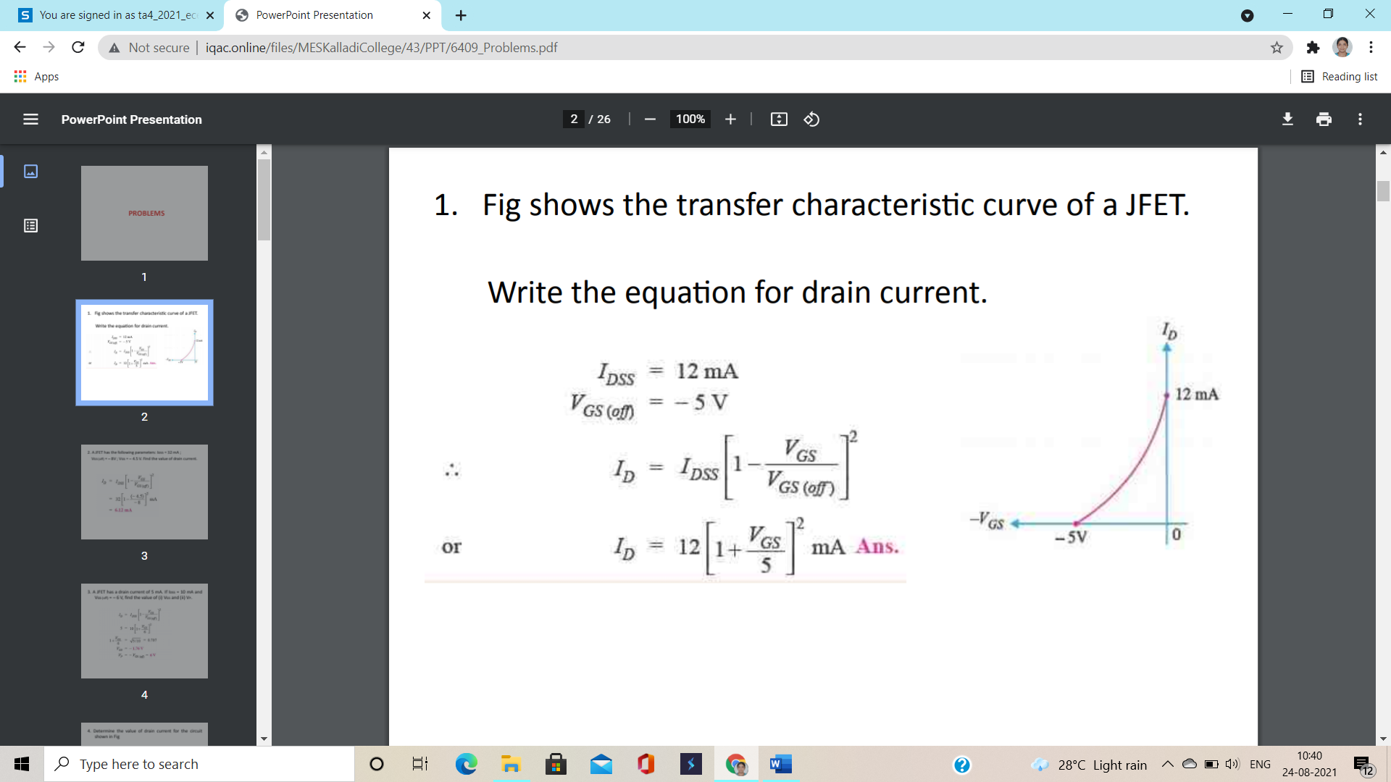
(2)

Slide 5
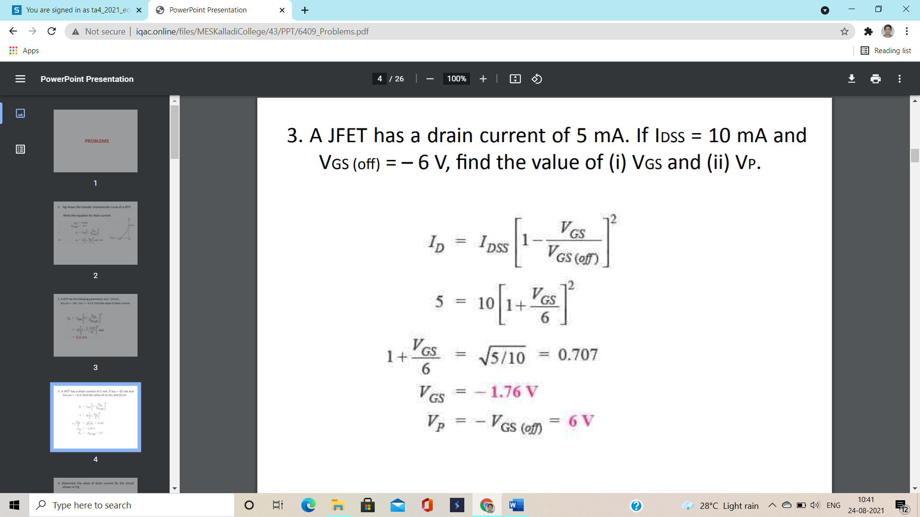
(3)

Slide 6
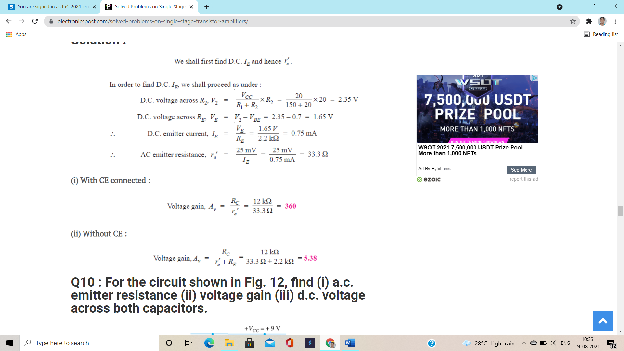
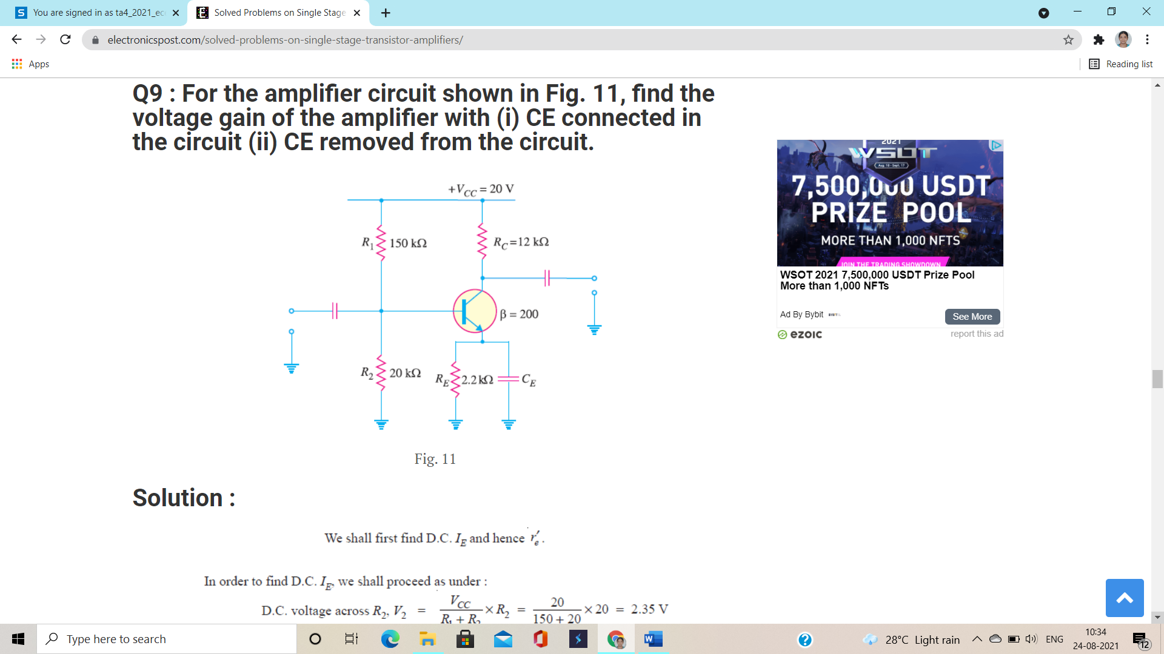
(4)
For the amplifier circuit shown find the voltage gain of the amplifier with (i) CE connected in the circuit (ii) CE removed from the circuit

Slide 7
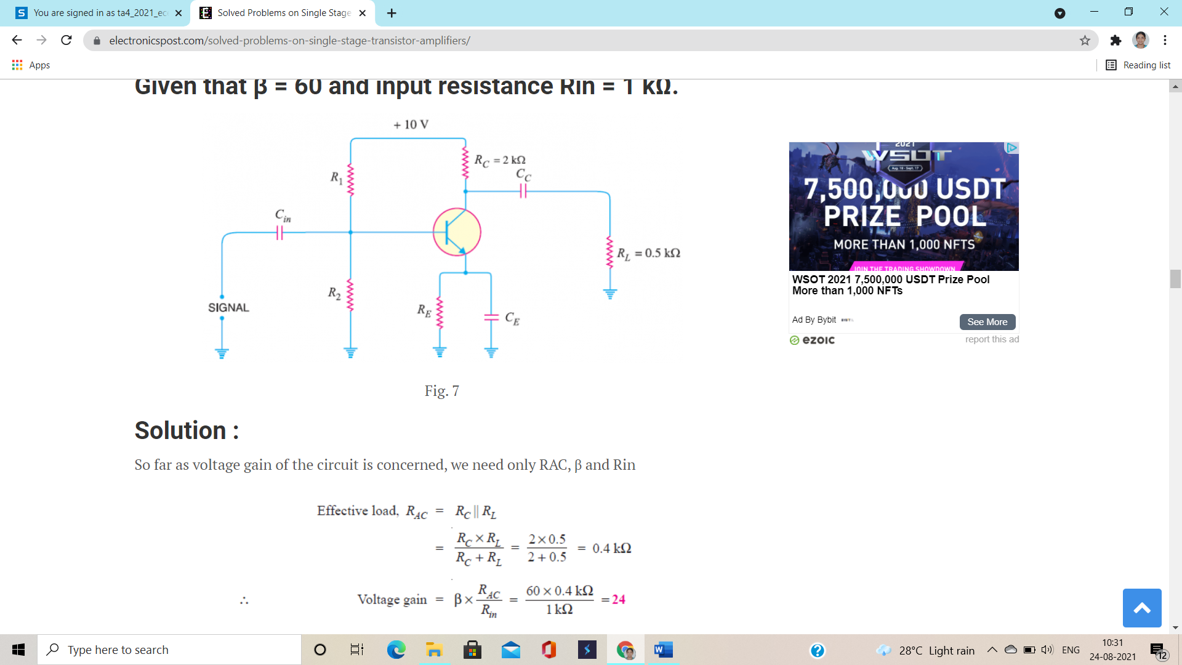
(5)
In the circuit shown find the voltage gain. Given that β=60 and input resistance Rin=1 k

Slide 8
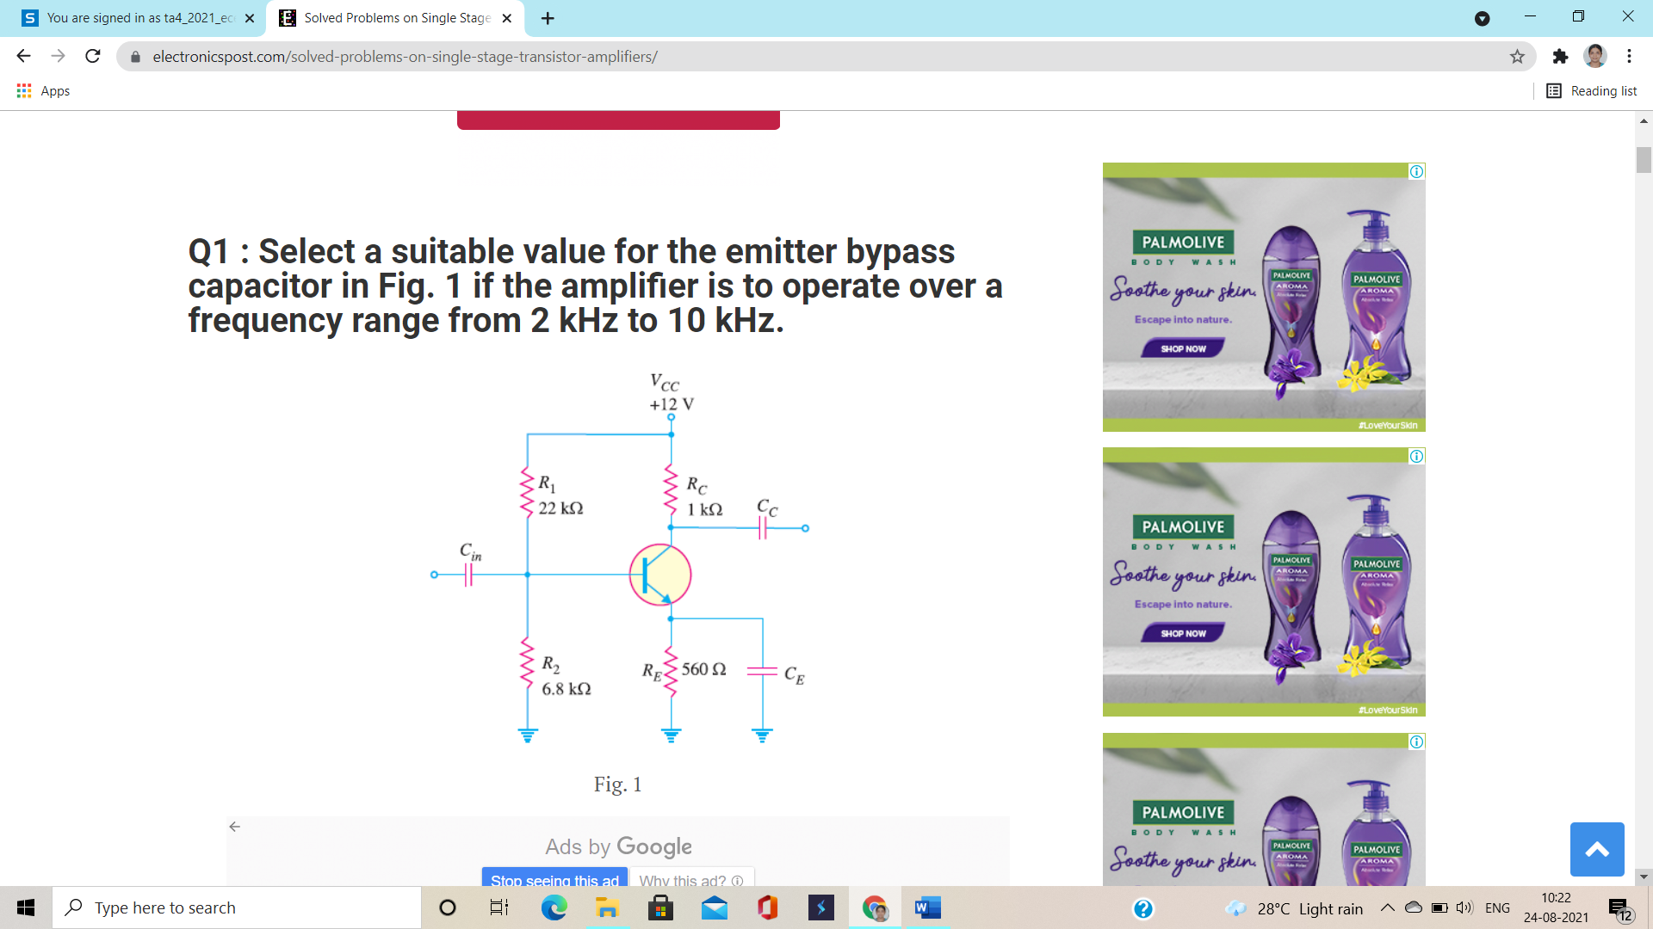
(6) Select a suitable value for emitter bypass capacitor in Fig shown if the amplifier is to operate over a frequency range from 2 kHz TO 10 kHz

Slide 9
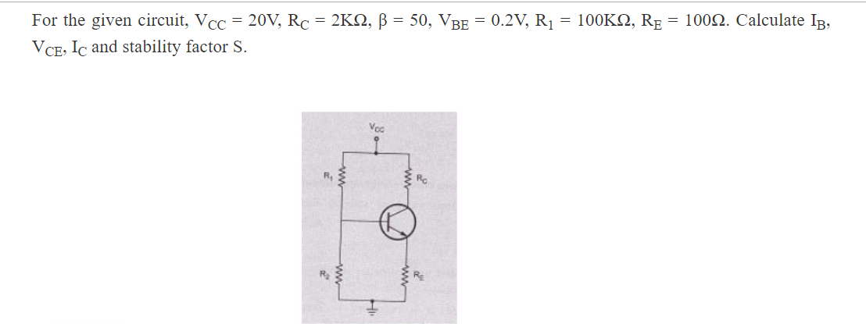
(7)

Slide 10
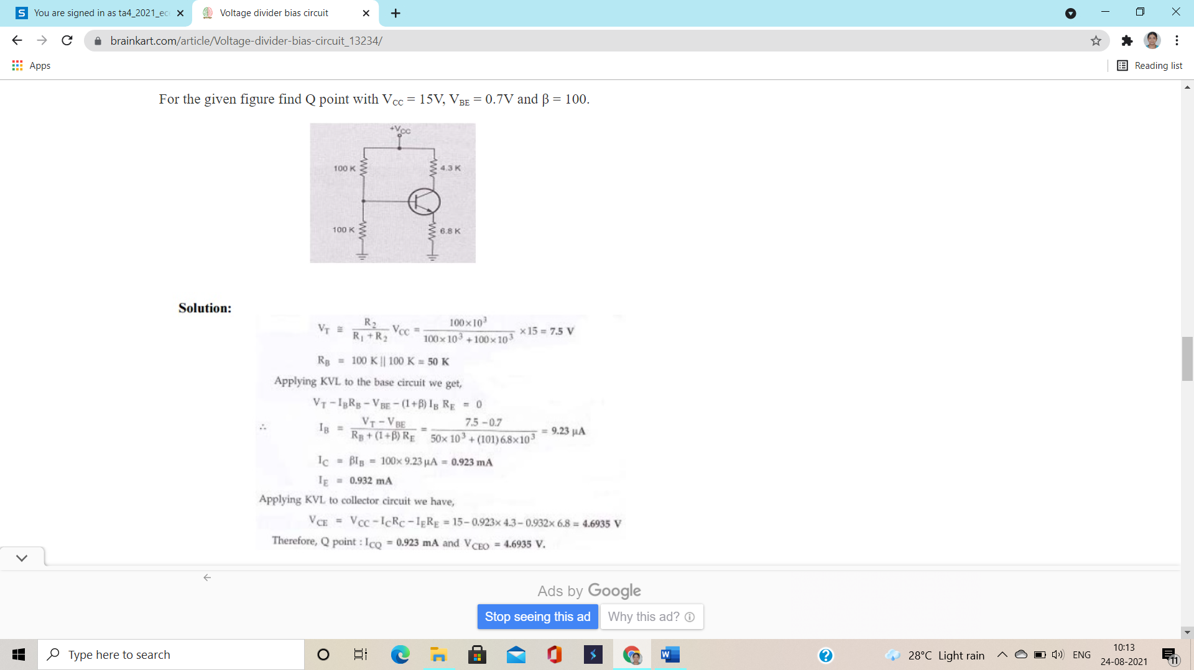
(8)

Slide 11
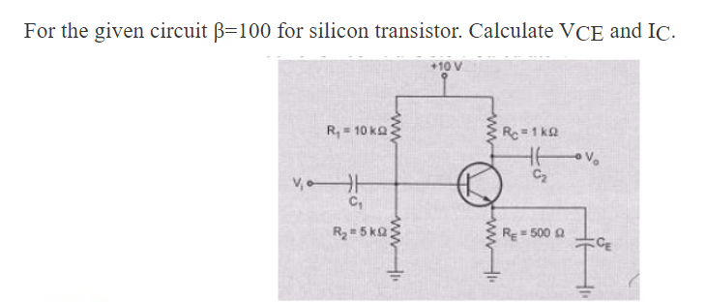
(9)

Slide 12
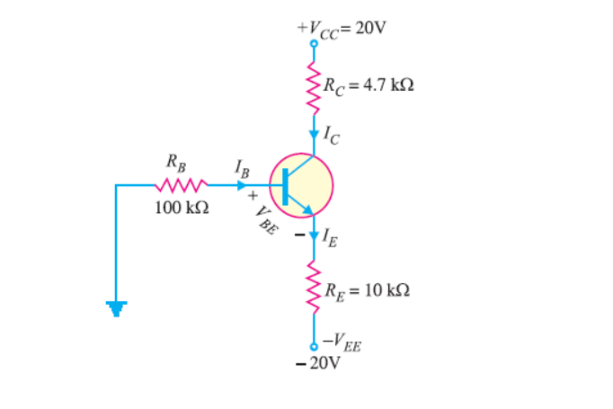
(10) For the emitter biased circuit shown Find IE, IC, VC, and VCE for β= 85 and VBE=0.7V

